Slide 1
PRT4828: InternSHip
Salt Lake City Watershed Department: Chris Knowlton

Slide 2
Watershed Department
Branch of Salt Lake City Public Utilities
Controls and manages the protected watershed areas that supply the Salt Lake Valley with 60% of drinking water, including City Creek, Parleys, Big, and Little Cottonwood Canyons.
My position: Seasonal Watershed Ranger
Duties Include: Patrolling and observing the watershed land. We aim to protect the environment and manage the water resources that these areas provide the city. Maintain and service campsite areas, local trails, water meters and valves, spring boxes, and public fountains.

Slide 3
Responsibilities
All watershed employees are required to drive and operate city vehicles and equipment. We drive trucks and trailers, and operate equipment such as pressure washers, trail maintenance tools, backpack sprayers, and a number of other things.
We are responsible for daily tasks given by the watershed managers, including trail maintenance, site cleanups, and daily observations.
Throughout the summer, we have also worked alongside the Utah Conservation Corps and the Division of Wildlife Resources, with various tasks that include invasive weed spraying and fish spawning.

Slide 4
Goals and Objectives
Goal 1: To increase my knowledge of watershed protection practices and techniques.
Objective 1: To work alongside experienced employees in the field everyday.
Objective 2: To learn industry language by reading department literature and learning new terms from co-workers.
Objective 3: To take tours of the water treatment plants and dams along the Wasatch front watershed, and eventually attend meetings with supervisors.
Goal 2: To be invited back as an employee for either full time or seasonal employment next year.
Objective 1: To receive feedback from supervisors and colleagues every 2 weeks. This could be in the form of three positive areas of my work, and three areas for suggested improvement.
Objective 2: Exit the internship with John to discuss areas of improvement for being considered next year.

Slide 5
Key Takeaways
The Salt Lake City Watershed is extremely important for the well-being of our residents and the entire Wasatch valley. It is true that this department does everything in their power to protect the environment that gives back to us. Salt Lake City residents should have good practices in the land to maintain its presence.
Group dynamics can make or break the workplace. This takeaway is key to any job that requires working alongside others. In my case, working with great people with likeminded passions made for a good working environment. My coworkers and I want to see each other succeed together. Having a positive mindset makes for a great experience everyday at work.
PRT coursework gave me the skills and confidence to succeed and reach my goals and complete the objectives of this internship.

Slide 6
Future Plans
Continue to work for the Watershed through the rest of the season (mid-October.)
I will be possibly returning next year, either in the same position or a different rank with larger responsibilities.
Ideally, I will work in the snow sports industry during the offseason, in a business position.
By using my references and acquired skillset during my coursework and internships, I can continue to explore different work explorations.

Slide 7
Recommedations
I would highly recommend this internship to future PRT students. The department is a great way to learn and work in a comfortable environment.
Anyone who loves being outdoors and exploring the Wasatch mountains would enjoy this internship.
Future students could also be interested in other branches of public utilities.

Slide 8
Questions??

Slide 9
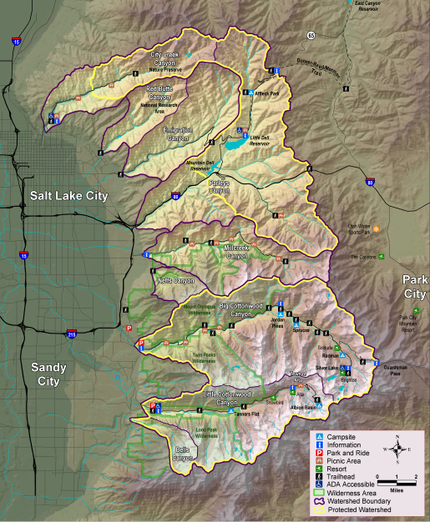
THE End

