Slide 1
PRT 3800: Internship
Chris Knowlton

Slide 2
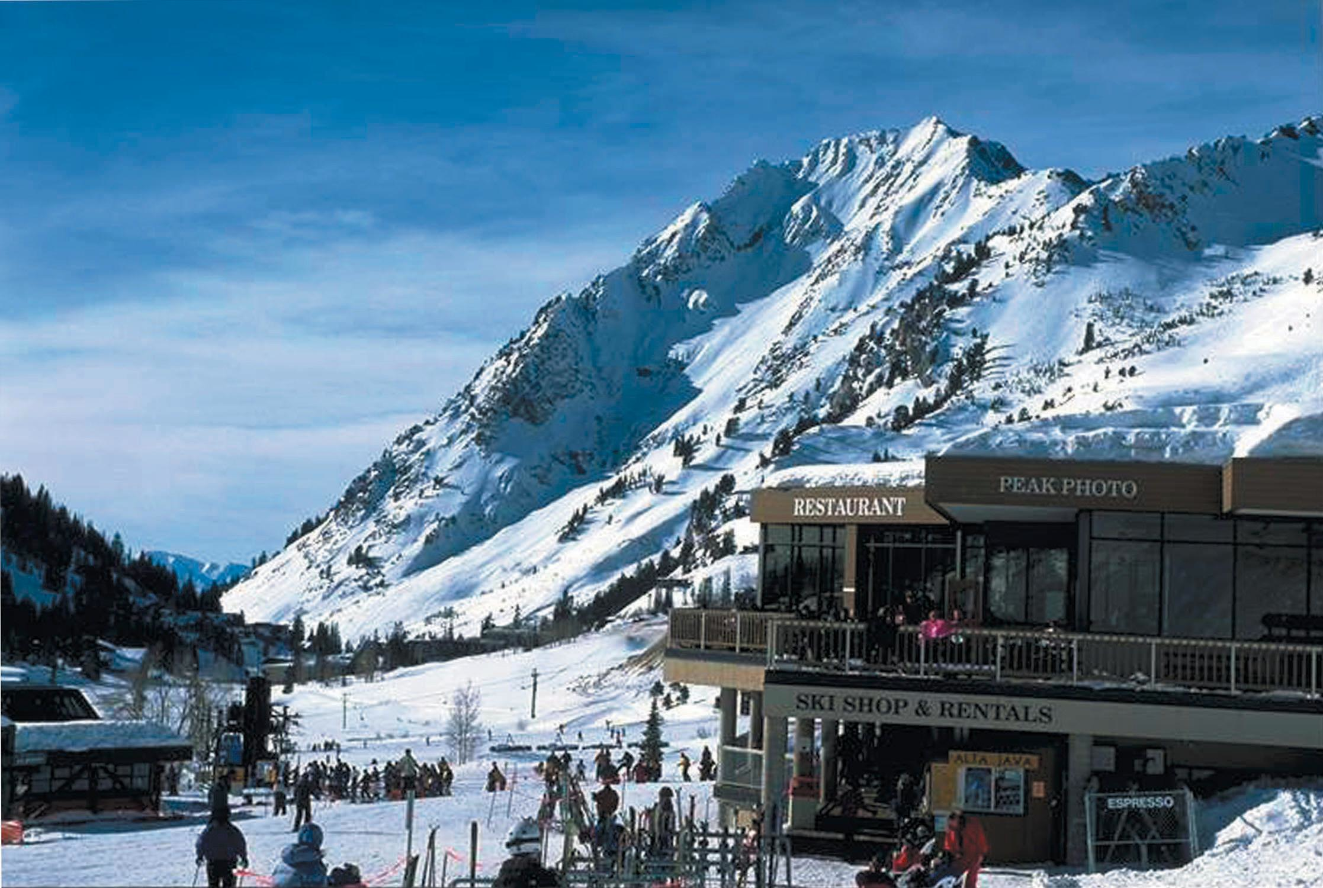
Alta Sports
Ski shop located at the Albion Base of Alta Ski Resort
Retail and rental services
Also has full repair shop and custom boot fitting to meet every skiers needs
30+ years of experience

Slide 3
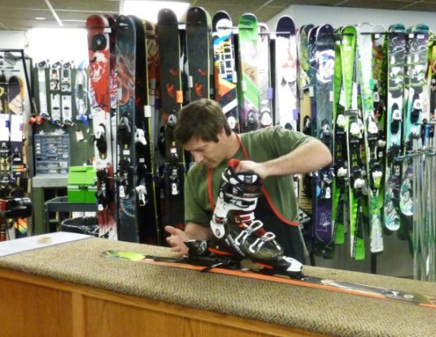
Equipment For Rent
Fleet and Demo Skis
Boots and Poles
Helmets and Goggles
AT Setups
Telemark Skis/Boots
Cross Country Skis/Boots
Snowshoes

Slide 4
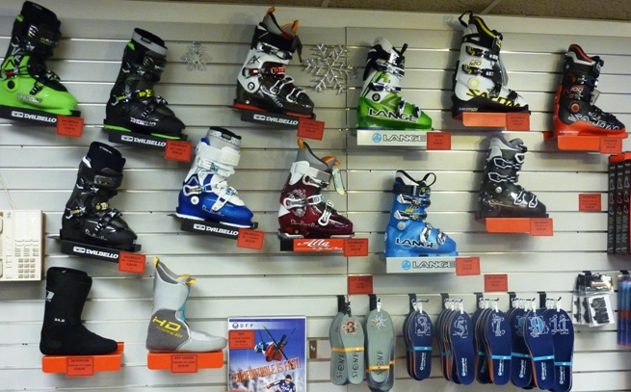
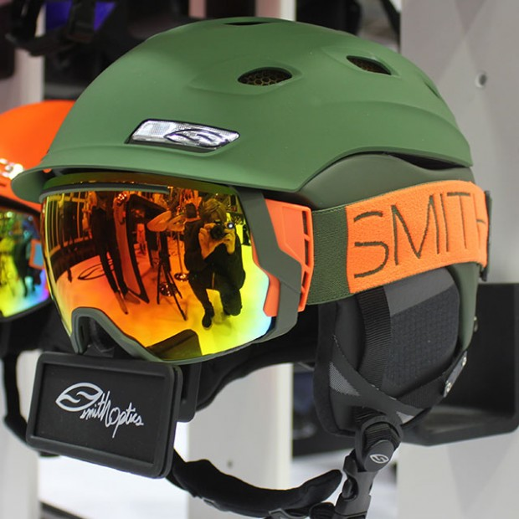
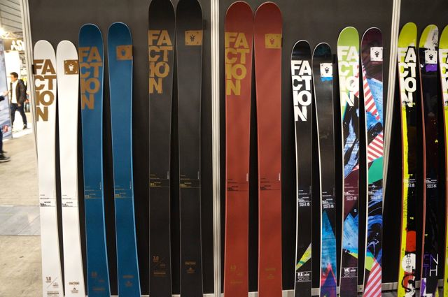
Products Carried
Skis: K2, Salomon, Faction, Fischer
Boots: Dalbello, Lange, Salomon
Bindings: Salomon, Marker, BD, 22 Designs, Dynafit
Outerwear & Accessories: Smith, Giro, Scott, Mountain Hardwear, Obermeyer, Marmot

Slide 5
My Role
As a rental and repair technician, I was responsible for customer services on a daily basis.
Trying on boots, sizing skis, filling out rental and shop tickets, running the cash register.
Repairing, mounting and maintaining skis. Base grinding and welding, edge and waxing.
Retail maintenance

Slide 6
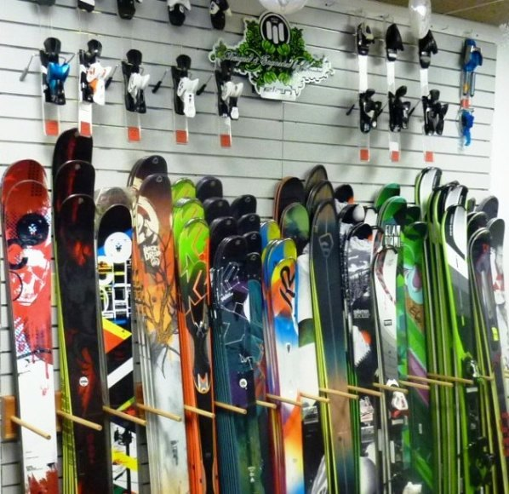
Shop Procedures
Open at 830, close at 530, 7 Days a week
Maintain and organize on a daily basis
Respect for the shop and coworkers
Honesty and Dependable
Working as a team

Slide 7
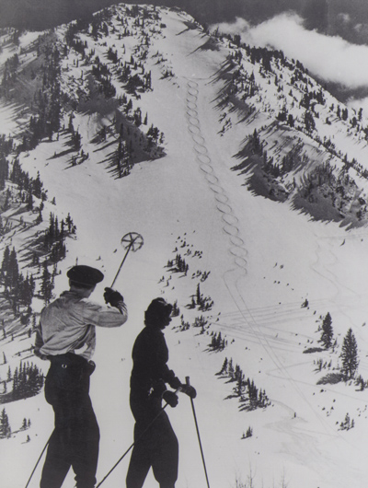
What I Learned
Patience, Responsibility, Customer Service
Liability and Risk Management
Accounting and Financials
Professionalism
Flexibility

Slide 8
Finals Thoughts
Location
Fast paced environment
Business Techniques
Good ownership and management
Conduct and business ethics standards
Benefits

Slide 9
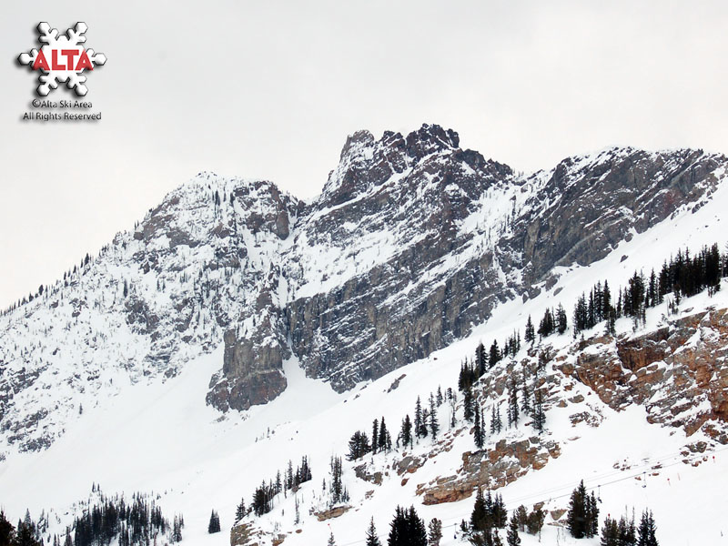
The End!

